Slide 1
SAP 1 Implementation in Verilog
Group Members:
Shahab Gul 21pwcse2033
Hamza Haider 21pwcse2050

Slide 2
Introduction:- Introduction to SAP 1 Project Implementation in Verilog
1. SAP 1 Project Overview:
- SAP 1 (Simple As Possible 1) architecture: Minimalist, educational computer architecture.
- Objective: Implement SAP 1 in Verilog for hands-on learning.
2. Project Goal:
Aligned with Computer Organization and Architecture course.
Gain practical insights into computer organization principles.
- Enhancing problem-solving and logical thinking skills.

Slide 3
SAP 1 Architecture Overview
Key Components:
Minimalist design with fundamental components: Registers /Memory/Control Unit
ALU (Arithmetic Logic Unit)
Functionality:
Highlights key functions of each component in executing instructions.
Simplified Design:
Emphasizes the simplicity of SAP 1 for educational purposes.

Slide 4
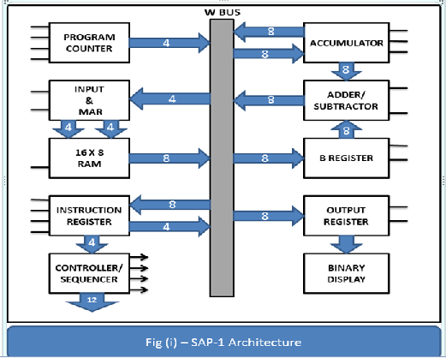
Block Diagram

Slide 5
Instruction Set
The SAP 1 architecture features a concise instruction set that governs its operations.
Sample Instructions:
Load (LDA): Loads data into registers.
Add (ADD): Performs addition operations.
Store (STA): Stores data into memory.
Highlight:
We've implemented these fundamental instructions, and additionally, introduced custom instructions tailored to project-specific requirements, enhancing the versatility of our SAP 1 model.

Slide 6
Verilog Implementation
Components Usage:
Multiplexer (Mux) and Demultiplexer (Demux):
Utilized in the Control Unit for selecting different pathways based on control signals.
Adder and Full Adder:
Used in arithmetic operations, contributing to the accumulator's functionality.
D Flip-Flop:
Employed for storing and transferring data during various phases of the instruction cycle.

Slide 7
Conclusion
Achievements:
Implemented a functional SAP1 architecture in Verilog.
Gained hands-on experience in digital design and computer architecture.
Future Directions:
Explore optimization opportunities for performance.
Share educational resources and engage with the community.
Final Thoughts:
The project serves as a foundation for continuous learning in computer science.

